Slide 1

Social Networks
Chris Piech
CS106A, Stanford University

Slide 2
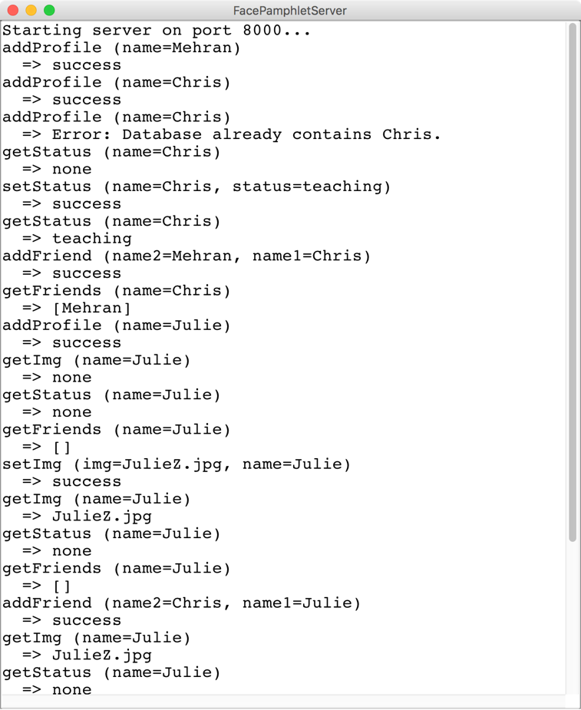
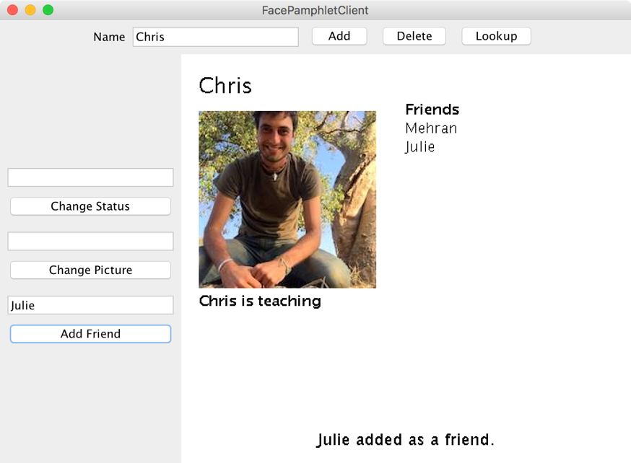
Face Pamphlet
FacePamphletServer
FacePamphletClient

Slide 3
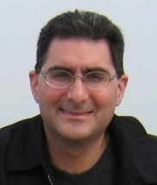

The Name
+
FaceBook
Thanks Mehran for the cool name

Slide 4

The Name
+
FaceLittlebook
Thanks Mehran for the cool name

Slide 5

The Name
+
FaceNovela
Thanks Mehran for the cool name

Slide 6

The Name
+
!!
FacePamphlet
Thanks Mehran for the cool name

Slide 7
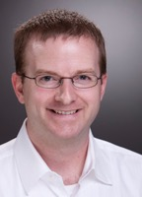

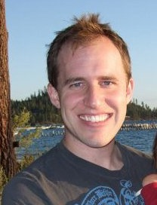
Some Context
A little background on Facebook
Facebook founded in 2004 by Mark Zuckerberg
He was a sophomore at Harvard
Facebook in 2012
More than 1 billion active users
10+ billion minutes/day spent on Facebook
You can do this!
Mike Schroepfer (Vice President, Engineering)
Jocelyn Goldfein (Director, Engineering)
Bret Taylor (former Chief Technology Officer)
All three were CS majors at Stanford
And all are former CS106A section leaders!

Slide 8
Review

Slide 9
Background: The Internet
The internet is just many programs sending messages (as Strings)
Thanks Nick for the teaching YEAH

Slide 10
Background: The Internet
Facebook datacenter
Your computer (facebook.com)
The internet is just many programs sending messages (as Strings)
Thanks Nick for the teaching YEAH

Slide 11
Background: The Internet
Facebook datacenter
Your computer (facebook.com)
“Server”
“Client”
The internet is just many programs sending messages (as Strings)
Thanks Nick for the teaching YEAH

Slide 12
Background: The Internet
Facebook datacenter
Your computer (facebook.com)
Get status for “Nick Troccoli”
“Server”
“Client”
The internet is just many programs sending messages (as Strings)
Thanks Nick for the teaching YEAH

Slide 13
Background: The Internet
Facebook datacenter
“response”
Your computer (facebook.com)
“teaching YEAH”
Get status for “Nick Troccoli”
“Server”
“request”
“Client”
The internet is just many programs sending messages (as Strings)
Thanks Nick for the teaching YEAH

Slide 14
FacePamphlet
FacePamphletServer
FacePamphletClient
RESPONSE
REQUEST
“Server”
“Client”
Your task
Extra credit
Thanks Nick for the teaching YEAH
Notes:
Respond to all the requests the client could send! (Each internet program has its own “protocol” for what messages it sends)

Slide 15
Another way to get Server/Client
First, imagine a world before Server/Clients…
Interacts with user /
displays information
FaceDatabase
FaceProfile
FaceGraphics
Stores information
* This blob represents one program on one machine

Slide 16
Another way to get Server/Client
First, imagine a world before Server/Clients…
FaceDatabase
FaceProfile
FaceGraphics
* This blob represents one program on one machine

Slide 17
Another way to get Server/Client
Now our application runs across two programs
Client
Server
RESPONSE
FaceGraphics
FaceDatabase
REQUEST
FaceProfile
* Each blob represents one program on one machine

Slide 18
Another way to get Server/Client
Which means many clients can connect to the data
Client
Server
RESPONSE
FaceGraphics
FaceDatabase
REQUEST
FaceProfile
RESPONSE
Client
FaceGraphics
REQUEST
* Each blob represents one program on one machine

Slide 19
The Internet
Facebook datacenter
RESPONSE
REQUEST
REQUEST
Your mom’s computer
(linux shell)
RESPONSE
“Server”
Tate Ole Keko’s computer (facebook.com)
Chris’ phone (facebook app)
“Client”
“Client”
“Client”

Slide 20
Most of the Internet
Aka “the frontend”
Aka “the backend”
Server / Clients
Aka “the cloud”
Aka “the GUI”
Aka “the brains”

Slide 21
Servers on one slide
public String requestMade(Request request) {
// server code goes here
}
1
2
// make a Server object
private SimpleServer server
= new SimpleServer(this, 8000);
3
public void run(){
// start the server
server.start();
}

Slide 22
Servers on one slide
public String requestMade(Request request) {
// server code goes here
}
1
2
// make a Server object
private SimpleServer server
= new SimpleServer(this, 8000);
3
public void run(){
// start the server
server.start();
}

Slide 23
What is a Request?
/* Request has a command */
String command;
/* Request has parameters */
HashMap<String,String> params;
Request request
// methods that the server calls on requests
request.getCommand();
request.getParam(key); //returns associated value

Slide 24
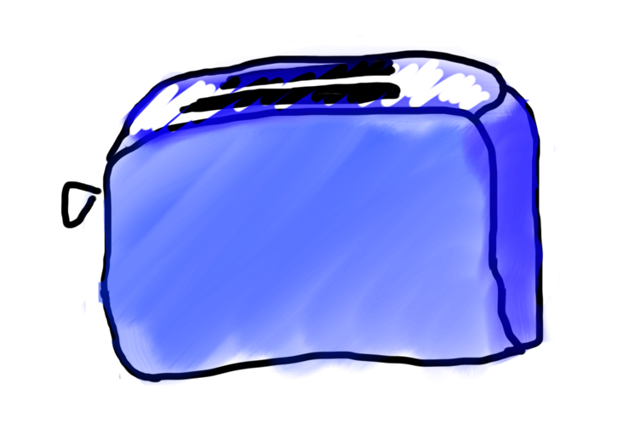
Requests are like Remote Method Calls
Server has a bunch of discrete things it can do
Server
addUser
getStatus

Slide 25
Requests are like Remote Method Calls
Server
addUser
getStatus

Slide 26
Requests are like Remote Method Calls
request.getCommand();
=> ”makeToast”
Server
addUser
getStatus

Slide 27
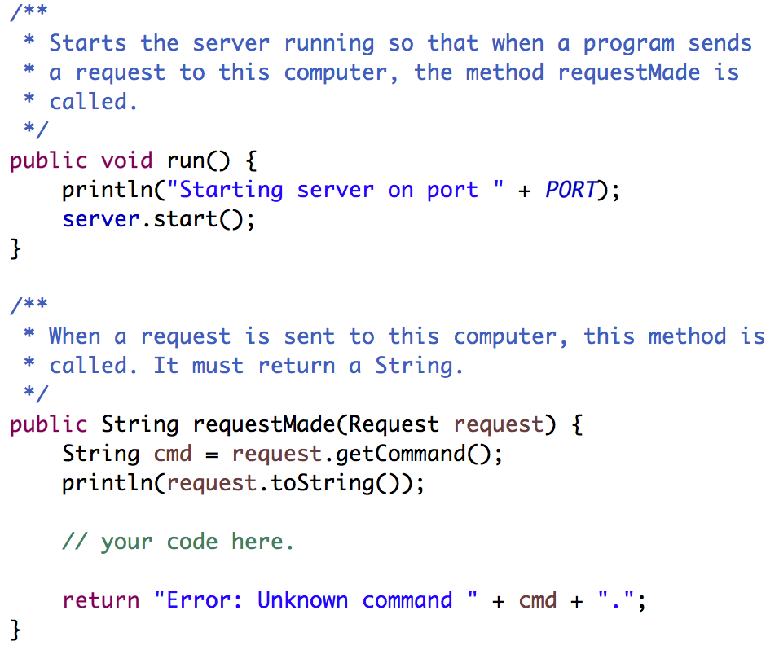
Your Server Code
Respond to requests here. The String you return will be sent as the response.
Notes:
What is a request? A way to structure messages so they’re consistent and easy to understand.

Slide 28
Where we left off...

Slide 29
There are two types of internet programs. Servers and Clients

Slide 30
Now, the client

Slide 31
A Clients’s Purpose
1. Interact with the user
2. Get data from its server
3. Save data to its server

Slide 32
Clients on one slide
try {
// 1. construct a new request
Request example = new Request("getStatus");
// 2. add parameters to the request
example.addParam("name", "chris");
// 3. send the request to a computer on the internet
String result = SimpleClient.makeRequest(HOST, example);
} catch(IOException e) {
// The internet is a fast and wild world my friend
}

Slide 33
Clients on one slide
try {
// 1. construct a new request
Request example = new Request("getStatus");
// 2. add parameters to the request
example.addParam("name", "chris");
// 3. send the request to a computer on the internet
String result = SimpleClient.makeRequest(HOST, example);
} catch(IOException e) {
// The internet is a fast and wild world my friend
}

Slide 34
Clients on one slide
try {
// 1. construct a new request
Request example = new Request("getStatus");
// 2. add parameters to the request
example.addParam("name", "chris");
// 3. send the request to a computer on the internet
String result = SimpleClient.makeRequest(HOST, example);
} catch(IOException e) {
// The internet is a fast and wild world my friend
}

Slide 35
Clients on one slide
try {
// 1. construct a new request
Request example = new Request("getStatus");
// 2. add parameters to the request
example.addParam("name", "chris");
// 3. send the request to a computer on the internet
String result = SimpleClient.makeRequest(HOST, example);
} catch(IOException e) {
// The internet is a fast and wild world my friend
}

Slide 36
Clients on one slide
try {
// 1. construct a new request
Request example = new Request("getStatus");
// 2. add parameters to the request
example.addParam("name", "chris");
// 3. send the request to a computer on the internet
String result = SimpleClient.makeRequest(HOST, example);
} catch(IOException e) {
// The internet is a fast and wild world my friend
}

Slide 37
Clients on one slide
try {
// 1. construct a new request
Request example = new Request("getStatus");
// 2. add parameters to the request
example.addParam("name", "chris");
// 3. send the request to a computer on the internet
String result = SimpleClient.makeRequest(HOST, example);
} catch(IOException e) {
// The internet is a fast and wild world my friend
}

Slide 38
Clients on one slide
try {
// 1. construct a new request
Request example = new Request("getStatus");
// 2. add parameters to the request
example.addParam("name", "chris");
// 3. send the request to a computer on the internet
String result = SimpleClient.makeRequest(HOST, example);
} catch(IOException e) {
// The internet is a fast and wild world my friend
}

Slide 39
Clients on one slide
try {
// 1. construct a new request
Request example = new Request("getStatus");
// 2. add parameters to the request
example.addParam("name", "chris");
// 3. send the request to a computer on the internet
String result = SimpleClient.makeRequest(HOST, example);
} catch(IOException e) {
// The internet is a fast and wild world my friend
}

Slide 40
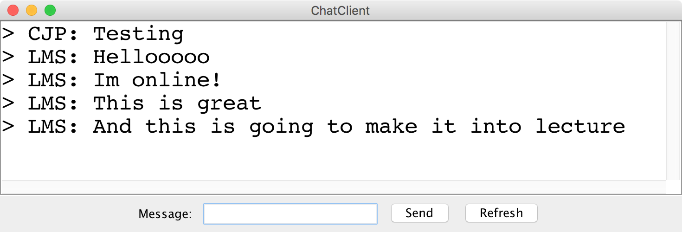
Chat Server and Client

Slide 41
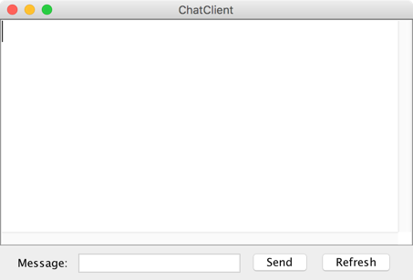
history = [
]
addMsg
msg = Hello world
Chat Client
Chat Client
Send
Hello world
Send

Slide 42
history = [
Hello world
]
getMsgs
index = 0
Chat Client
Chat Client
Send
Send

Slide 43
Chat Server
addMsg
msg = text
Chat Server
getMsgs
index = startIndex

Slide 44
There are two types of internet programs. Servers and Clients

Slide 45
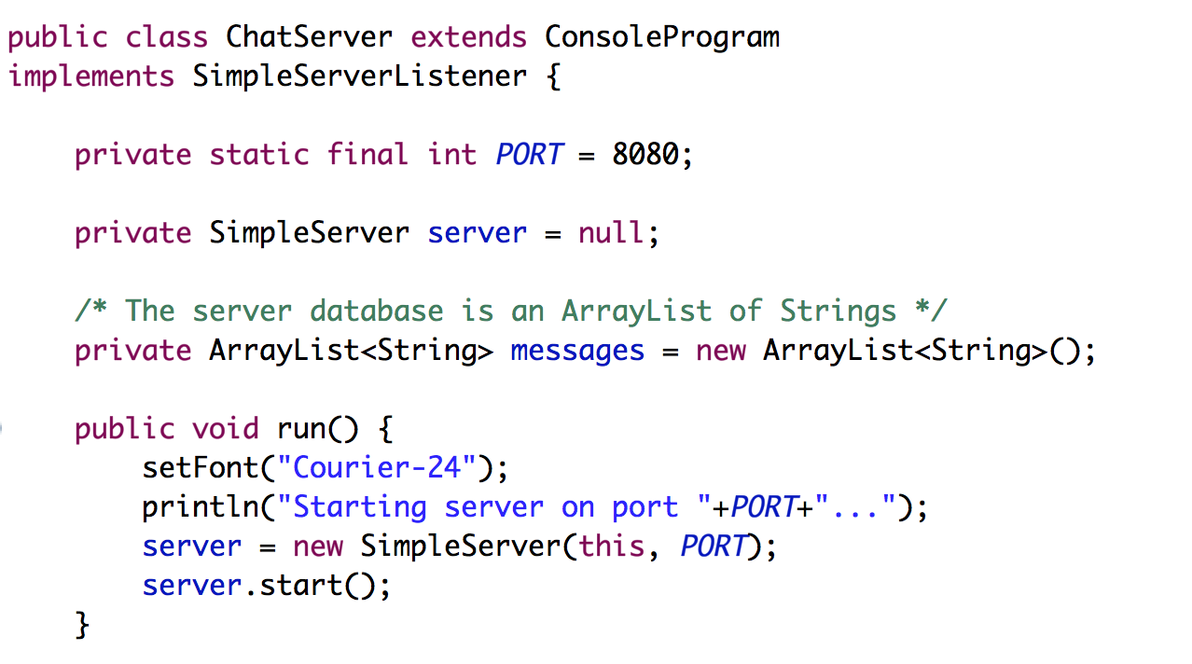
Chat Server
… that’s not all

Slide 46
Chat Server
… that’s not all

Slide 47
Chat Server
… that’s not all

Slide 48
Chat Server
… that’s not all

Slide 49
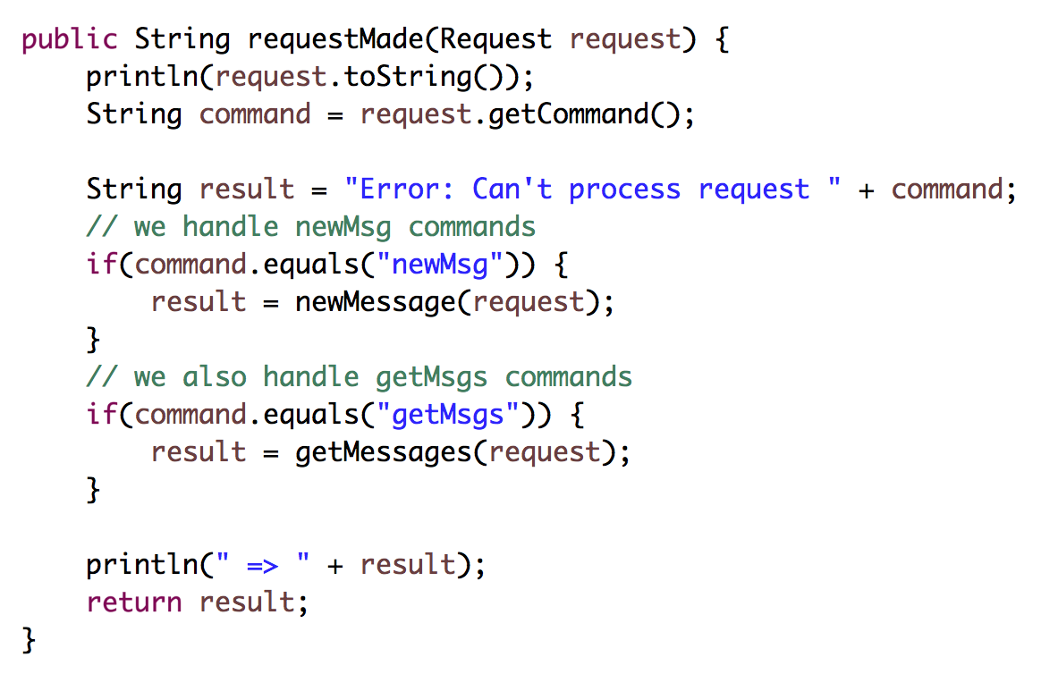
Chat Server (continued)

Slide 50
Chat Server (continued)

Slide 51
Chat Server (continued)

Slide 52
Chat Server (continued)

Slide 54
FAQ

Slide 55
Question: This is cool Chris.
But didn’t you just really
dumb down servers?

Slide 56
Answer: No

Slide 57
Question: Why isn’t this in a browser?

Slide 58
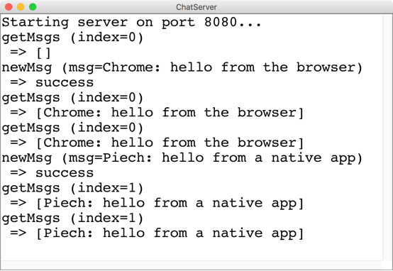
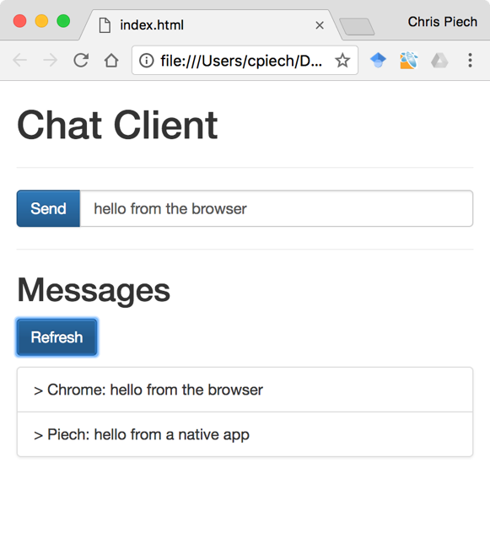
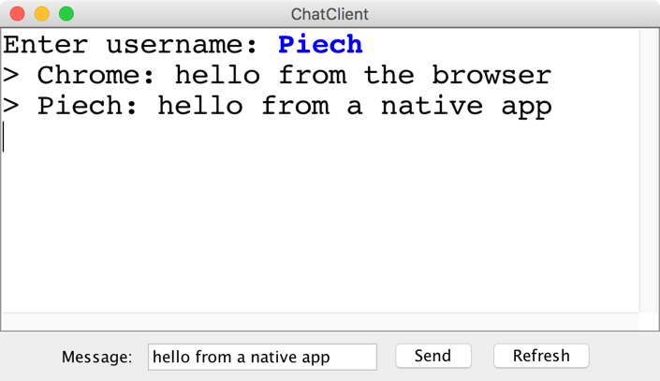
“Native” vs “Browser”

Slide 59
Question: Localhost forever?

Slide 60
Use ngrok to get a url

Slide 62
Any security holes?

Slide 63
Want to learn more?
CS144 Computer Networking
Or CS193P
Or CS193A
Or CS108

Slide 64
Social Networks

Slide 65

Who Do You Love
Who do you love?
And how does Facebook know?

Slide 66
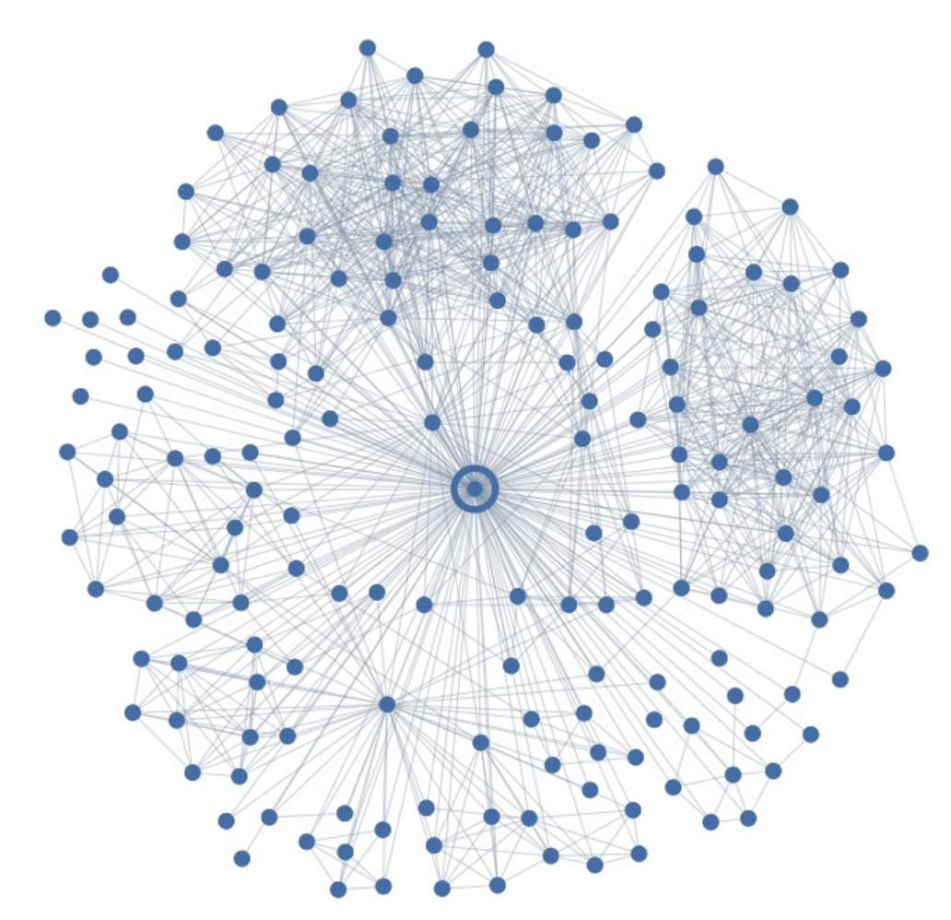
Ego Graph
Your local social network

Slide 67
Maybe I Love These People?
You have some “groups”

Slide 68
But I Actually Love This Person
But here is the love of your life
Your significant other
George

Slide 69
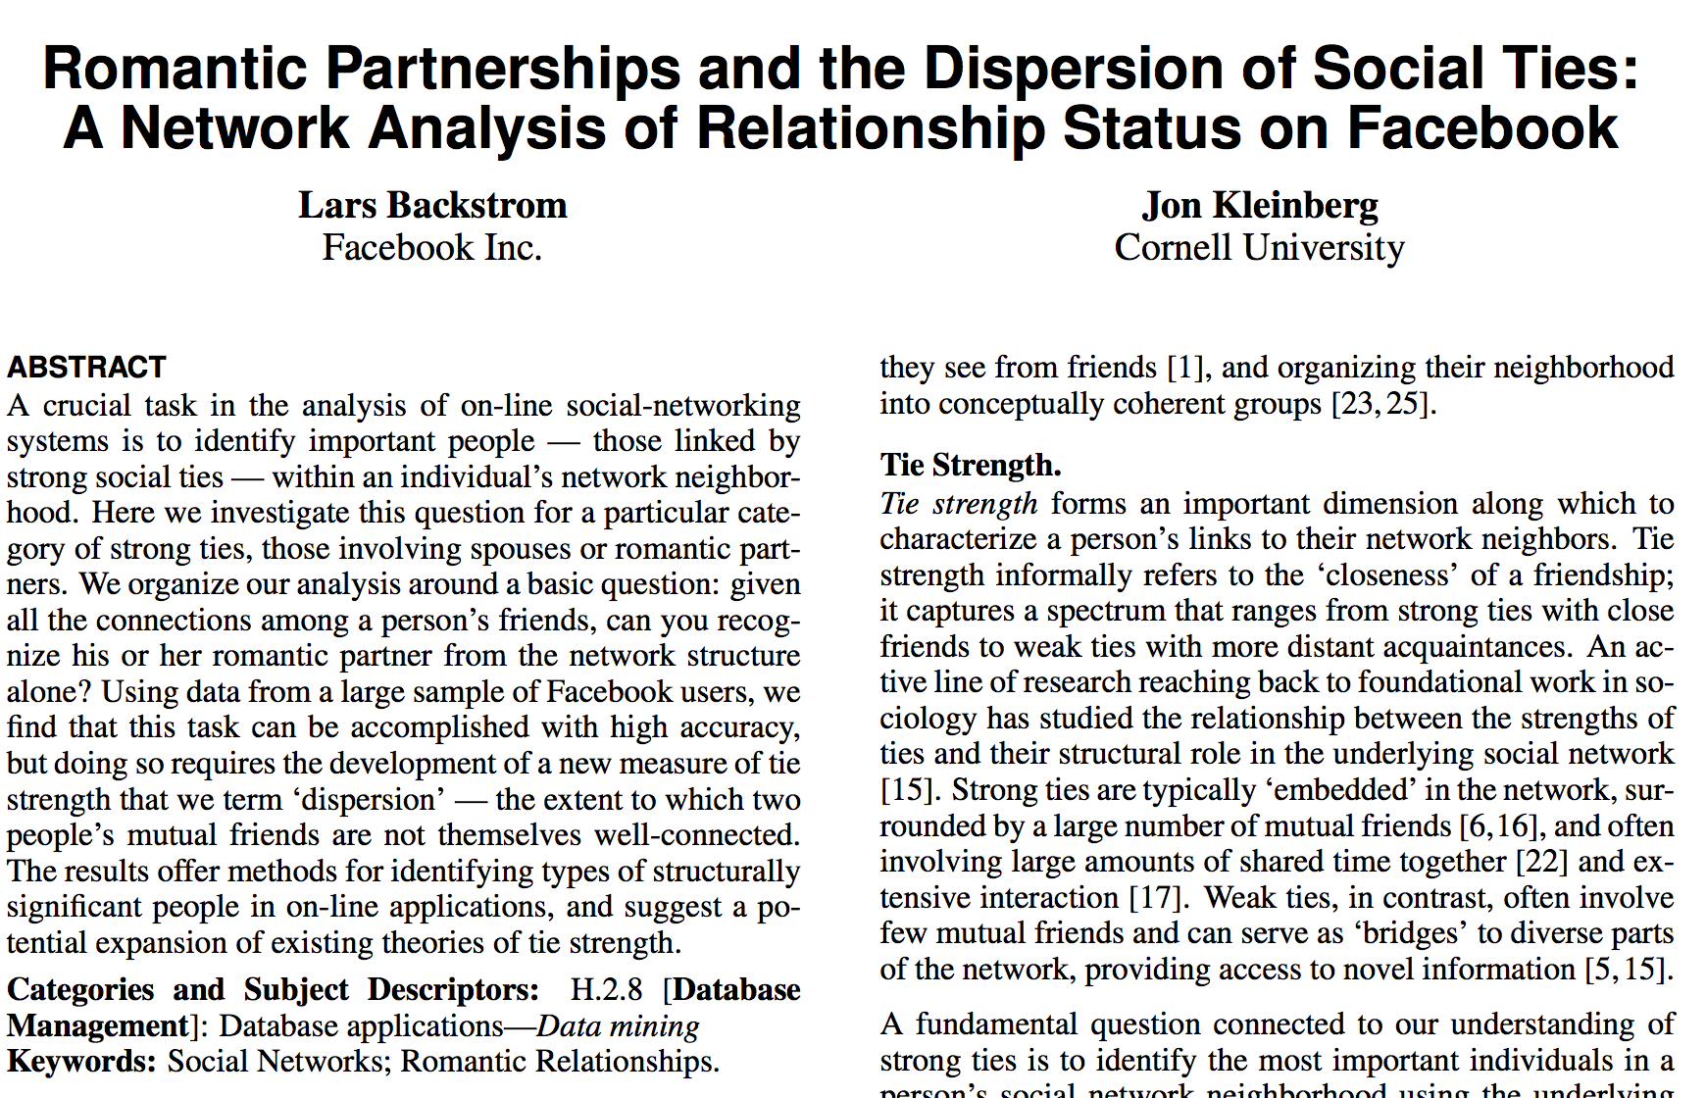
Romance and Dispersion
Romance and Social Networks
October 2013
http://arxiv.org/pdf/1310.6753v1.pdf

Slide 70
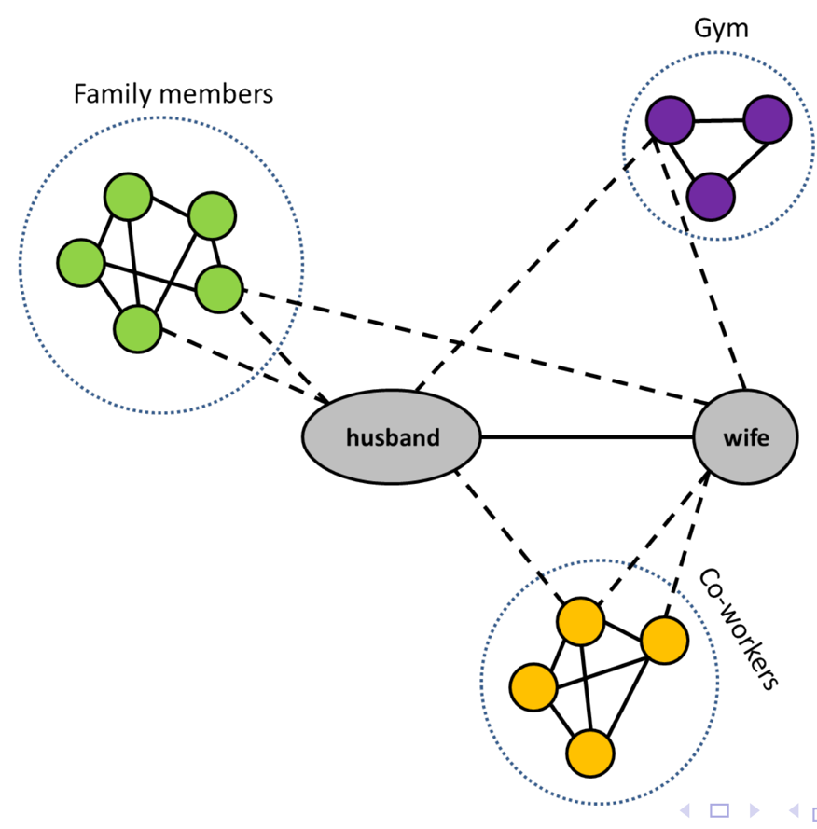
Dispersion Insight
Romance and Social Networks
Dispersion: The extent to which two people’s
mutual friends are not directly connected

Slide 71
Dispersion Insight
Mining Massive Datasets
CS246: Mining Massive Datasets
Or CS106B or CS103 or CS109
Dispersion: The extent to which two people’s
mutual friends are not directly connected

Slide 72
The filter bubble

Slide 73
Elections, now hackable

Slide 74
The end.

